Slide 1
Lab4: Communication & Camera
TA Suhwan Sung
acgnkpiyrw@kaist.ac.kr
April 14, EE405 Elec Design Lab. <Robot manipulator> TA Session

Slide 2
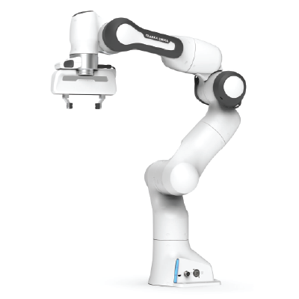

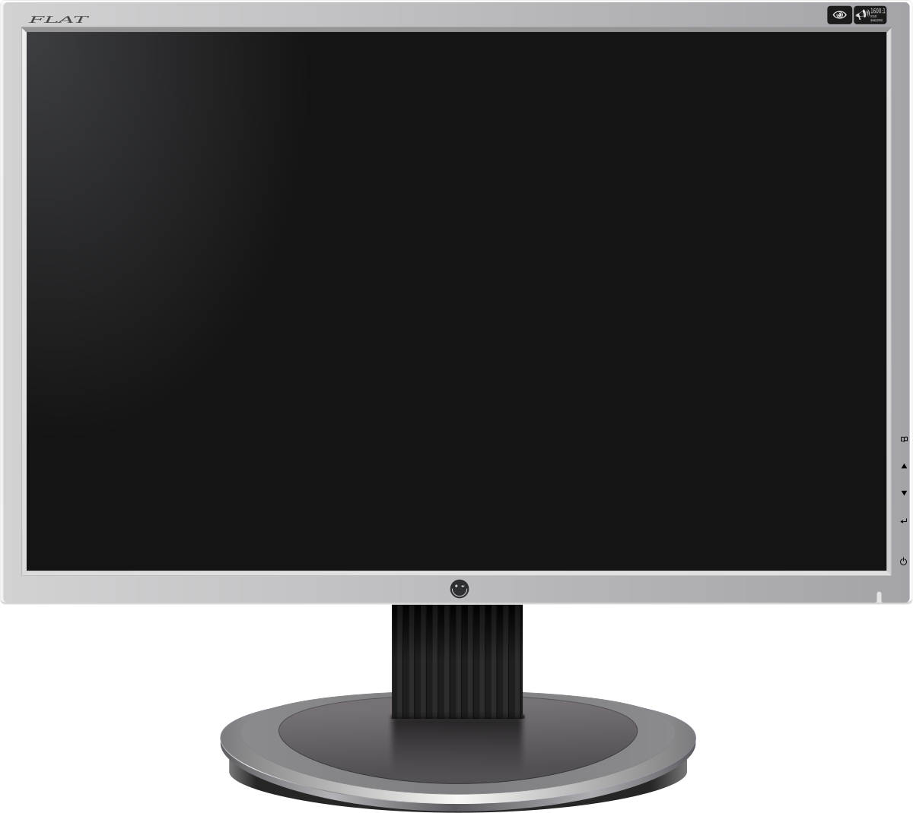
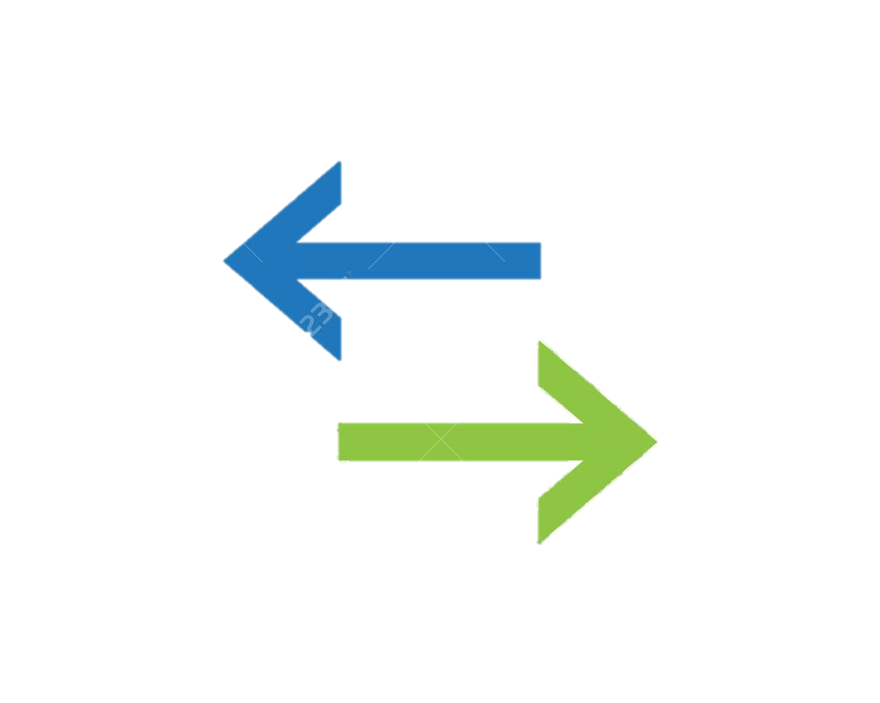

Purpose of the Lab
EE405 TA Session: Lab 4
Camera Screen
We will control the robot via teleoperation.

Slide 3
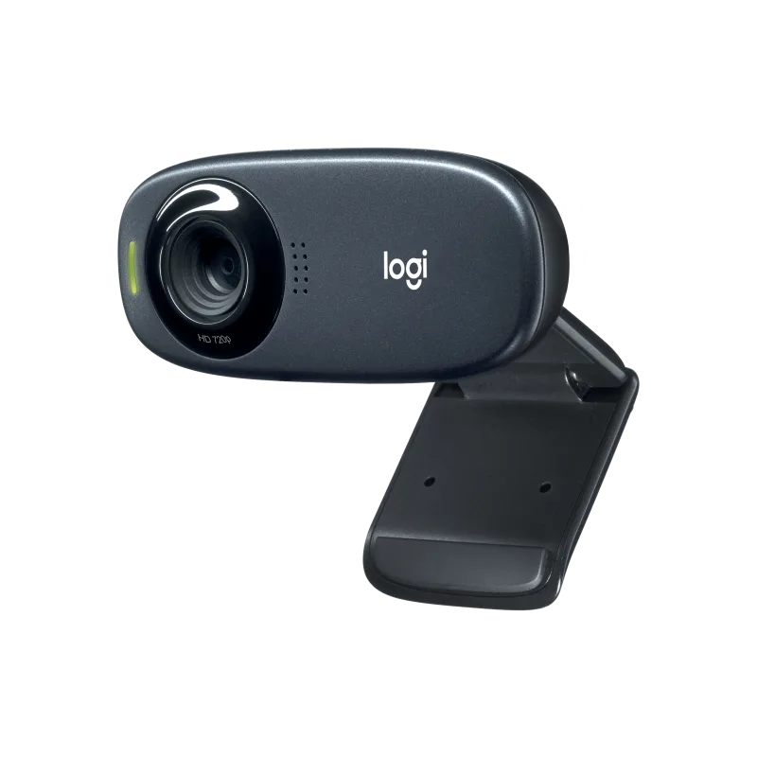
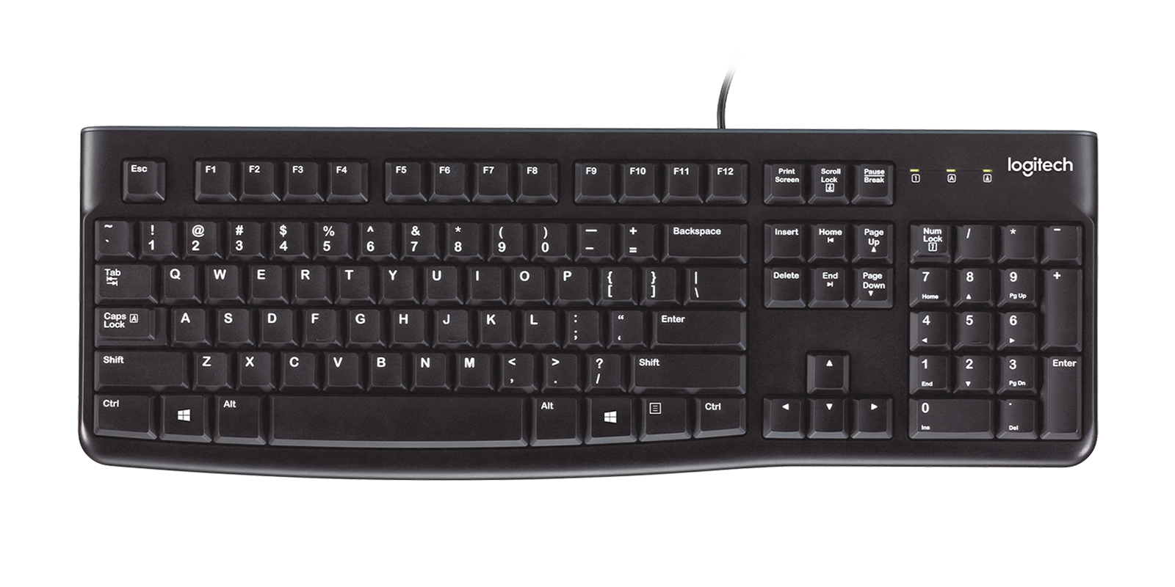
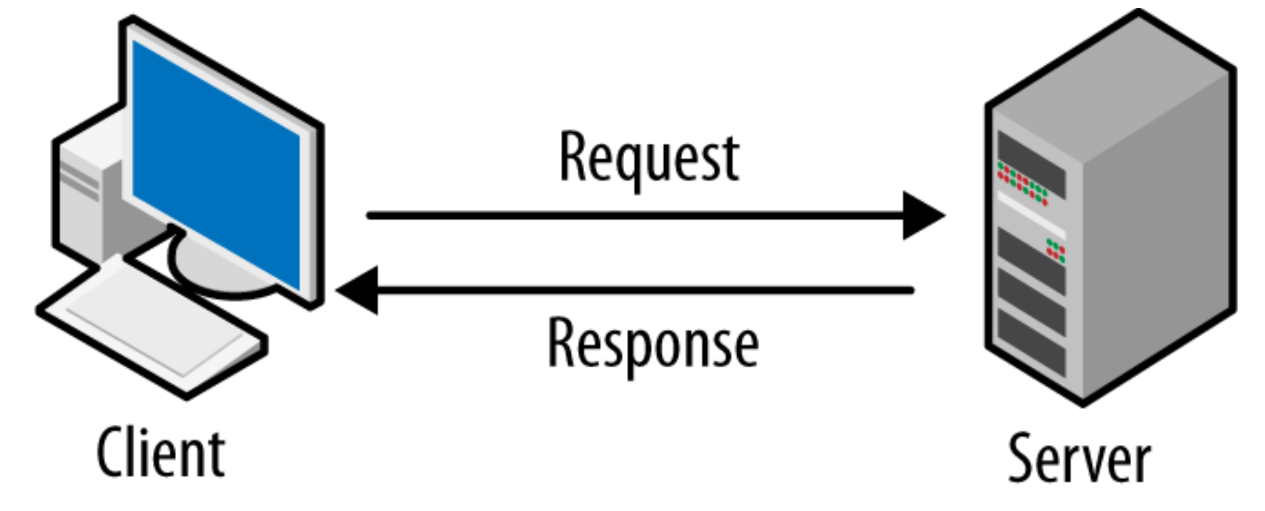
Mainly 3 parts
EE405 TA Session: Lab 4
Part 1: Communication Part 2: Remote controller implementation Part 3: Camera Utility

Slide 4
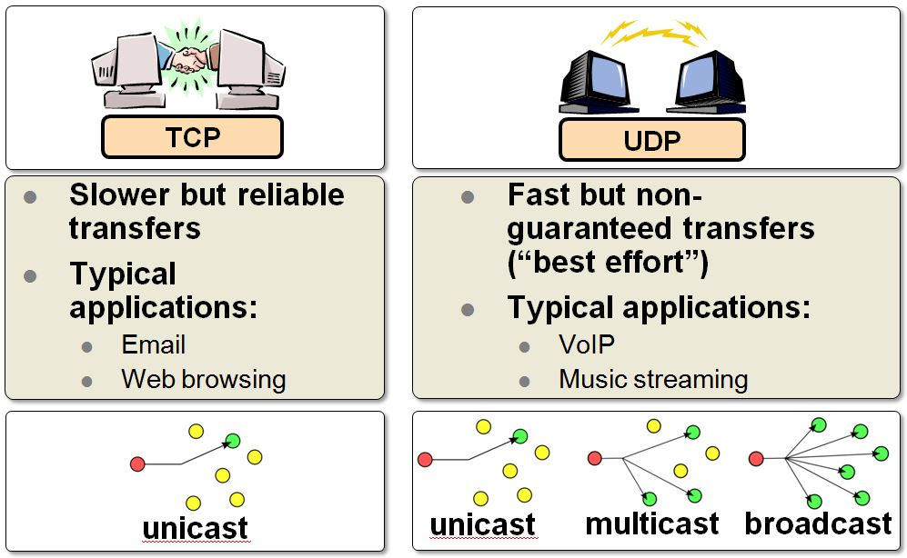
1. Communication: TCP vs. UDP
EE405 TA Session: Lab 4

Slide 5


Comm. Protocol for Robot Control
EE405 TA Session: Lab 4
Real-time communication is very important for robot control
→ Use UDP network

Slide 6
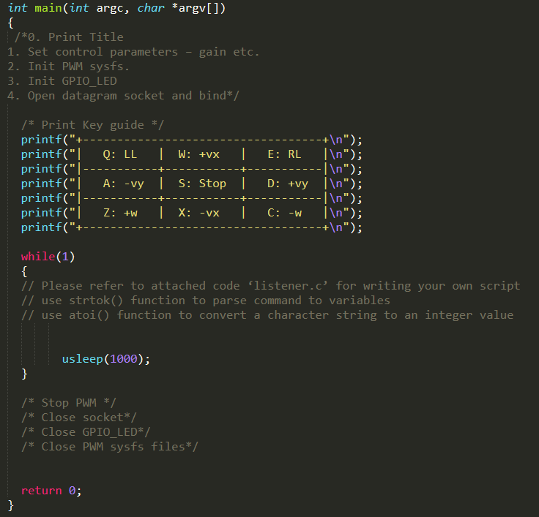
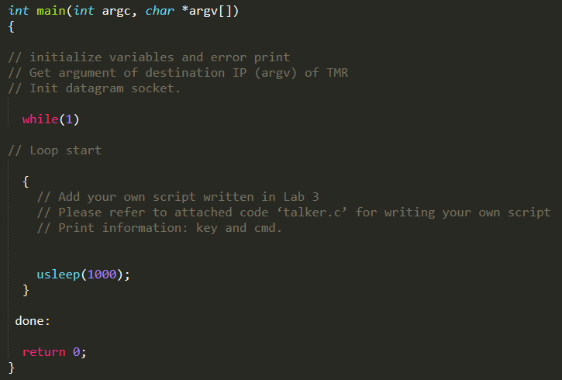
2. Remote Controller Impl.
EE405 TA Session: Lab 4
PC Part
(Send keyboard input)
Bone Part
(Receive keyboard input)

Slide 7
2. Remote Controller Impl.
EE405 TA Session: Lab 4
You may spend most of time for implementation. But don’t be scared. All the other part is provided and very easy.
You will reuse most part of the Lab2 and the example in the previous part. (UDP example)

Slide 8

3. Camera Utilities & Streaming Demo
EE405 TA Session: Lab 4
Video4Linux (V4L) is a collection of device drivers and an API for supporting realtime video capture on Linux systems
FFmpeg is a free and open-source software project consisting of a suite of libraries and programs for handling video, audio, and other multimedia files and streams.

Slide 9
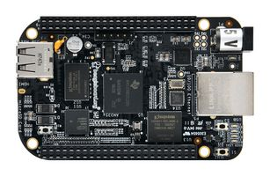
3. Camera Utilities & Streaming Demo
EE405 TA Session: Lab 4
Bone
PC
UDP Network (via FFmpeg)
V4L2 library
We will use both libraries:
V4L2 for gathering Webcam screen,
FFmpeg for streaming via UDP network.

Slide 10
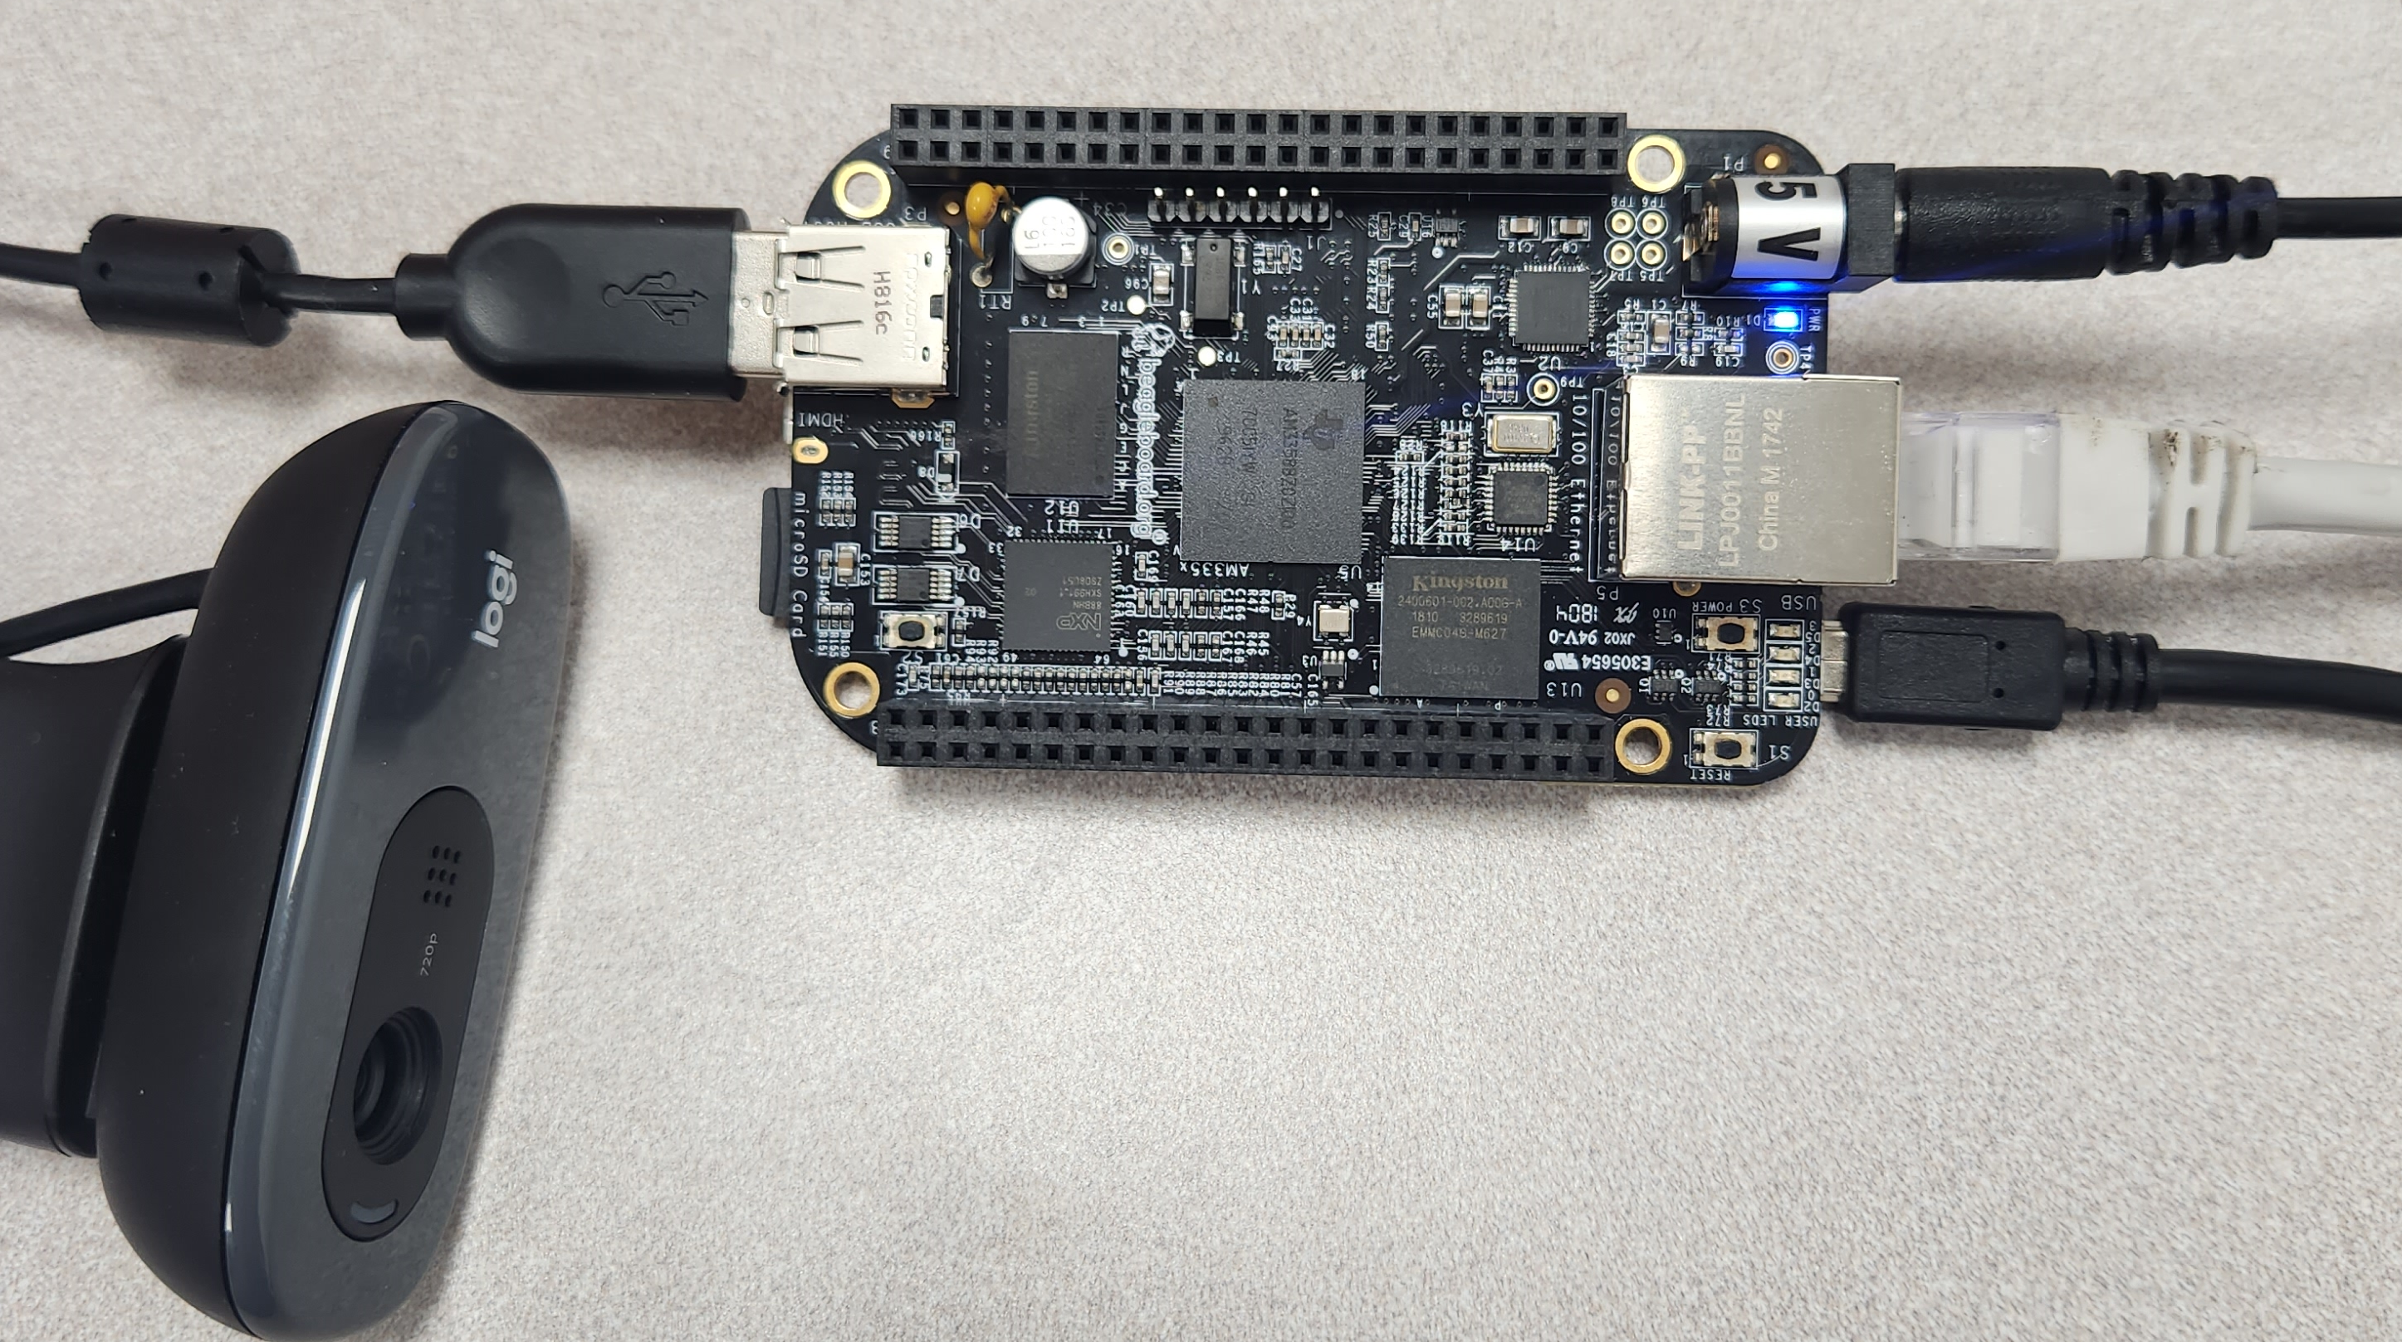
Bone Setting
EE405 TA Session: Lab 4
Connect All:
Ethernet
Power
USB Cable
Webcam

Slide 11
Lab report
EE405 TA Session: Lab 4
Include detail procedures and discussion as many as possible!
Discussion is most important part of the lab.
Troubleshooting is also important. Please show your effort you did.

Slide 12
EE405 TA Session: Lab 4
Any Questions?
Notes:
OK

